Slide 1

Wisconsin Diagnostic Breast Cancer Dataset (WDBC Dataset)
By Hector Gonzalez, Bryce Costa

Slide 2
Hypothesis:
The characteristics of a cell nuclei (mass), including data such as values of radius, texture and area, are significant variables to determine the severity of the nuclei is either benign(non harmful) or malignant(harmful).

Slide 3
Key Features in Breast Cancer Diagnostics
Radius: The radius measures the average distance from the tumor center to it’s edge, with larger or uneven values potentially indicating malignancy.
Texture: Texture represents variations in gray scale intensity within the tumor, where greater variation may signify irregular tissue linked to malignancy.
Perimeter: The perimeter is the total length around the tumor edge, which tends to be longer and more irregular in the malignant tumors.
Area: Area indicators the total size of the tumo, with larger areas often associated with malignancy.
Smoothness: Smoothness reflects how regular or irregular the edges of the tumor are, with jagged edges commonly linked to malignant growth.
Compactness: Compactness measures the tumor’s shape efficiency, where a higher value suggests a less predictable and possibly malignant growth pattern.
Concavity: Concavity describes how deeply the tumor’s edges curve inward, with more severe curves hinting at aggressive growth.
Concave points: Concave points count the inward curves on the tumor edge, with more curves indicating malignancy.
Symmetry: Symmetry evaluates how balanced the tumor’s shape is, with asymmetry often pointing to malignancy.
Fractal Dimension: Fractal dimension quantifies the complexity of the tumor boundary, where higher values reflect the irregular and jagged contours typical of malignancy.

Slide 4
Statistical Hypothesis
Determining whether there is a relationship between data set features such as (Worst Radius, Worst Area, Worst Texture) and the diagnosis of the patient (Malignant or Benign).
Null Hypothesis: the selected features do not have a statistically significant relationship with the tumor diagnosis (Benign or Malignant).
Alternate Hypothesis: one or more of the selected features has a statistically significant relationship with the diagnosis of the tumor.

Slide 5
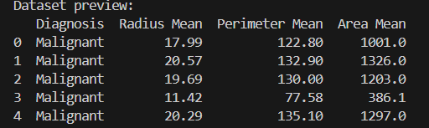
Statistical Analysis

Slide 6
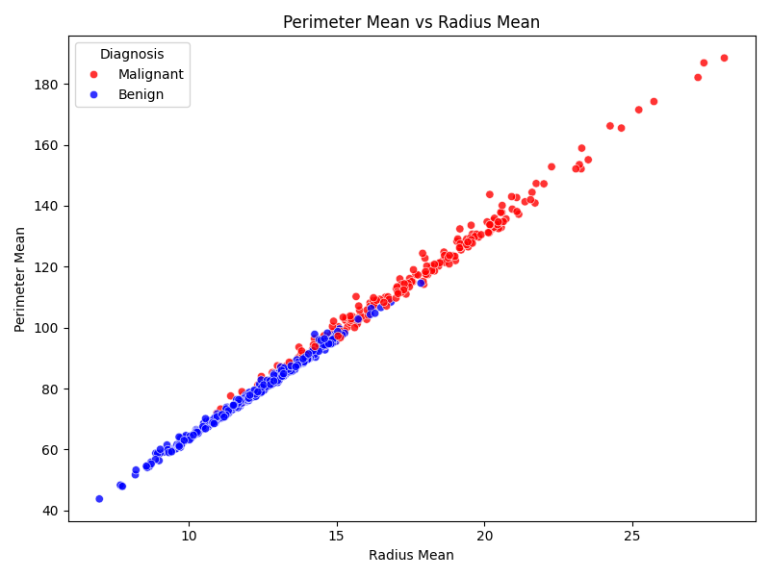

Slide 7
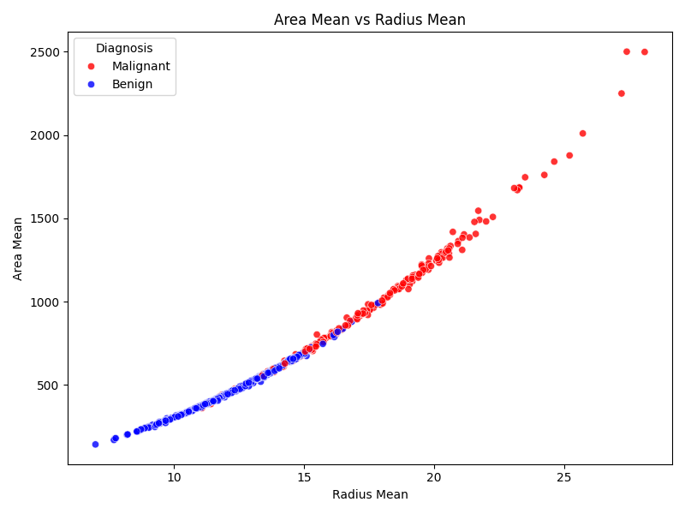

Slide 8
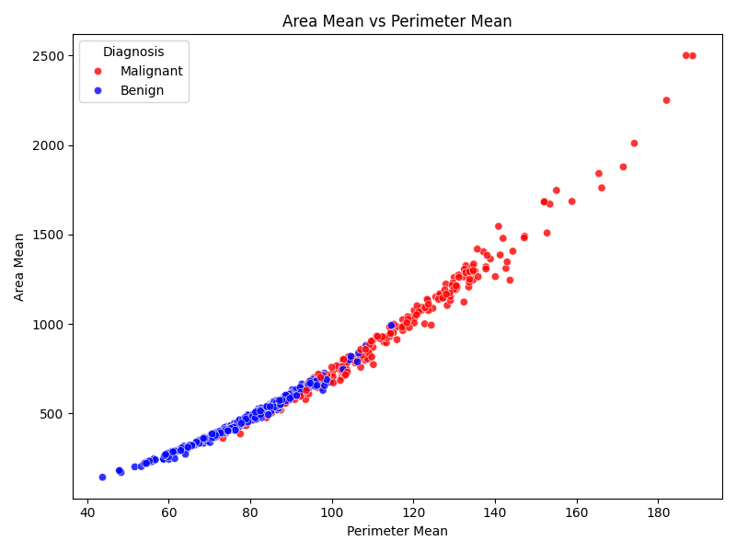

Slide 9
Conclusion
Based on the Dataset and our Statistical Analysis, we can prove that the alternate hypothesis we mentioned was correct. This means:
The data sets are factors of diagnosis
The data sets have a positive correlation between size of the parameter and diagnosis.

Slide 10
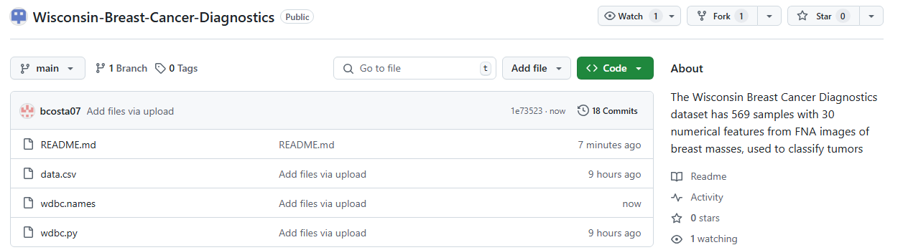
GitHub
GitHub Link (WDBC)

